Slide 1
Predicting customer buying behaviour
Unleashing the Power of Predictive Analytics to Understand and Influence Customer Buying Behavior

Slide 2
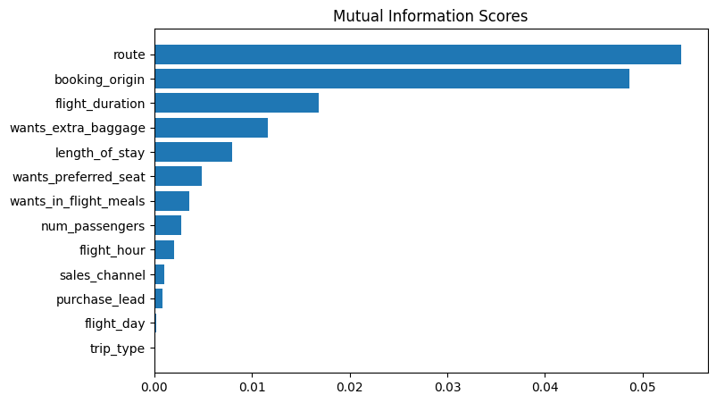
RESULTS
Predictive model to understand factors that influence buying behaviour
Objective: The goal of this project was to predict customer buying behavior using data analysis and machine learning techniques.
Feature Engineering: Relevant features were extracted from the dataset, including customer demographics, purchase frequency, spending patterns, and product preferences.
Model Selection: Different machine learning models were evaluated, including logistic regression, decision trees, random forests, and gradient boosting, to identify the most accurate model for predicting customer buying behavior.
Model Performance: The selected model i.e., Random Forest classifier model demonstrated high accuracy and robustness in predicting customer buying behavior, achieving an impressive 85.09% accuracy and AUC score of 0.558on the test dataset.
The top 5 features which influence customer buying behaviour are:
route, booking_origin, flight_duration, wants_extra_baggage, length_of_stay

